Slide 1

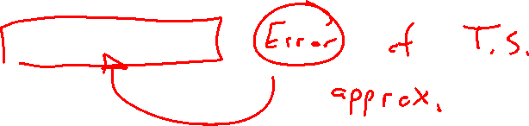
Section 1.2 Math Preliminaries
Lecture 2
Taylor's Theorem
Notes:
Section is shorter than most

Slide 2
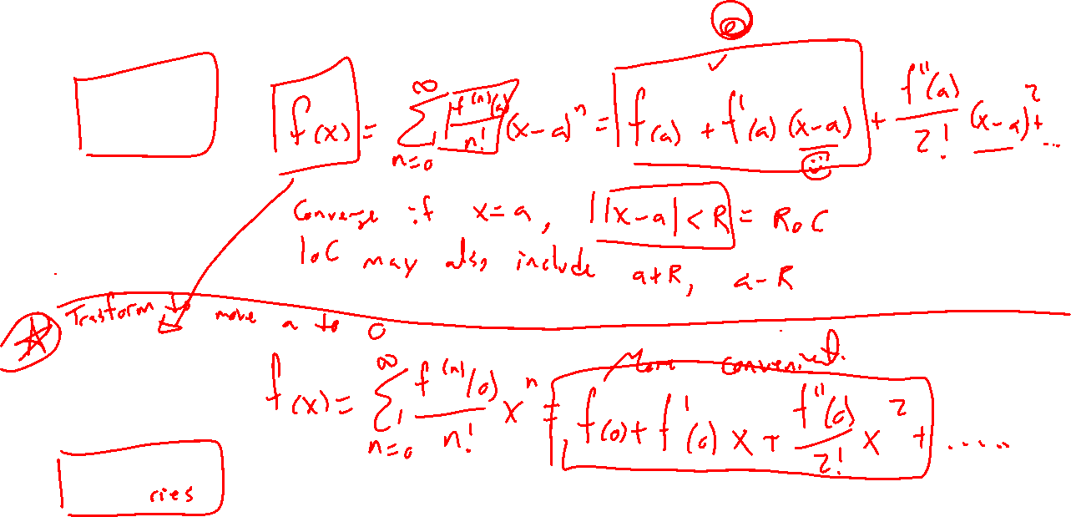
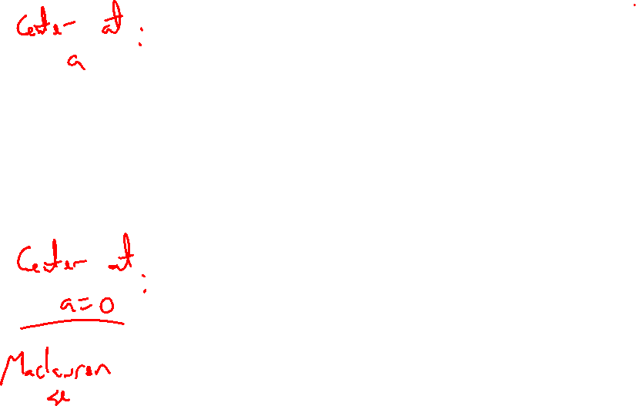
Recall: Taylor series formula

Slide 3
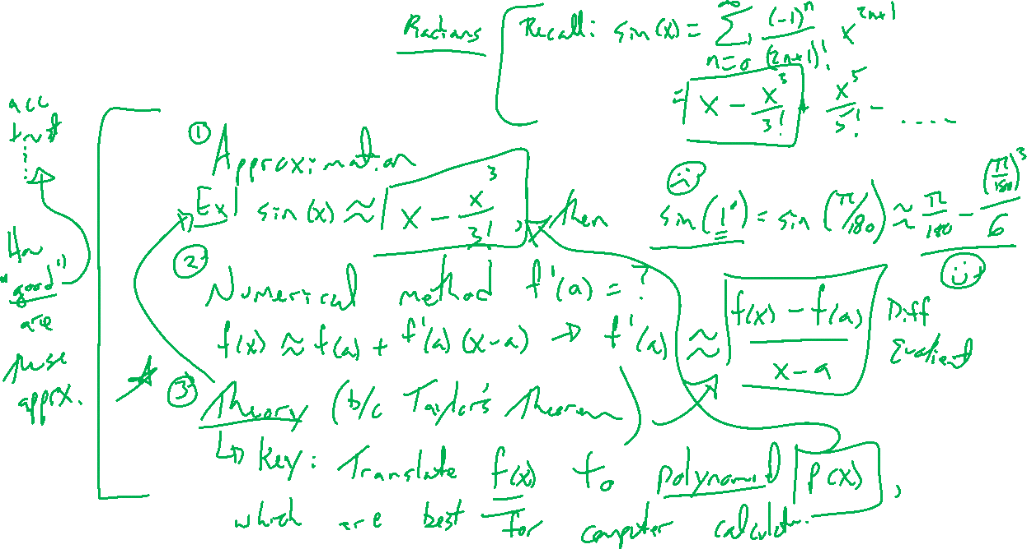
Why Taylor series?
Notes:
Approximation: sin(x) \approx x+x^3/6, then sin(1 deg) \approx ...
Numerical method: f(x) \approx f(a) + f'(a)(x-a) gives f'(a) \approx …
Theory: General approach for any function so long as the series converges. Polynomials are best representation for computers.
Key question: How accurate are these approximations?

Slide 4
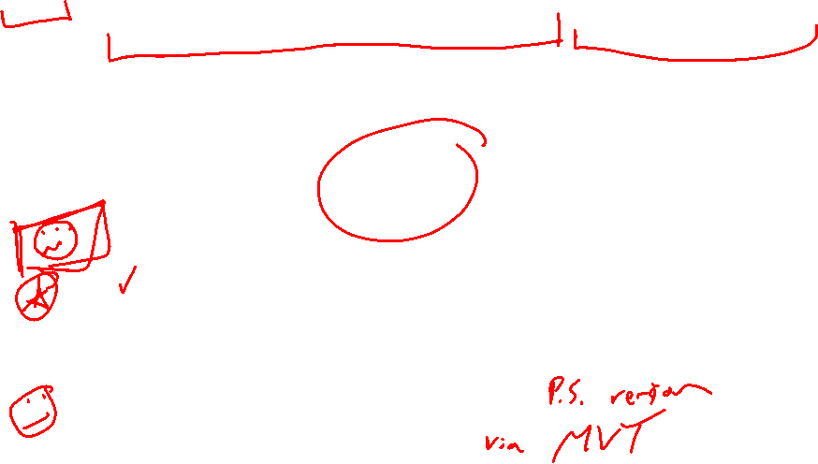
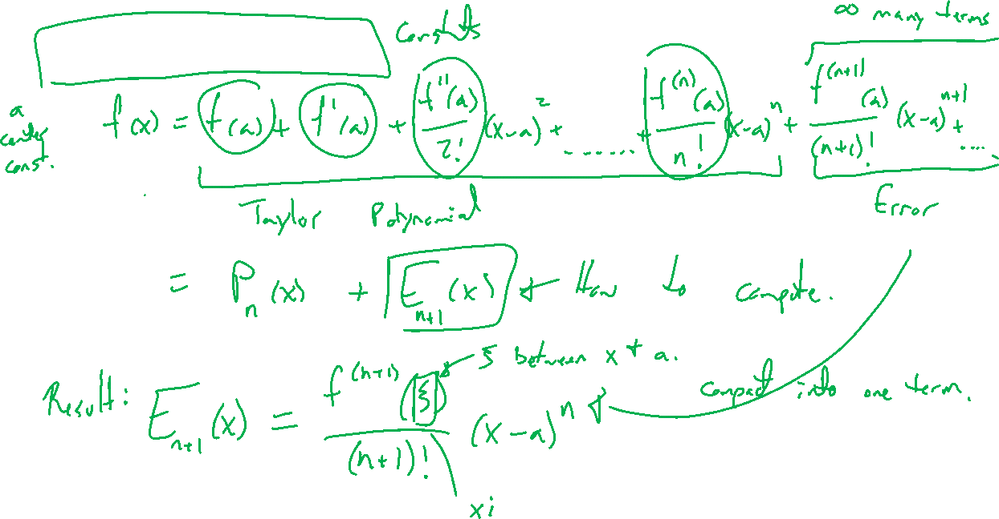
Taylor's Theorem
Notes:
F(x) = P_n(x) + E_{n+1} for P_n the degree n Taylor polynomial and error term E_{n+1} such that
E_{n+1} = f^{n+1}(\xi)/(n+1)! (x-a)^{n+1}
Special case: n=0 and the MVT, draw picture from calculus 1.

Slide 5
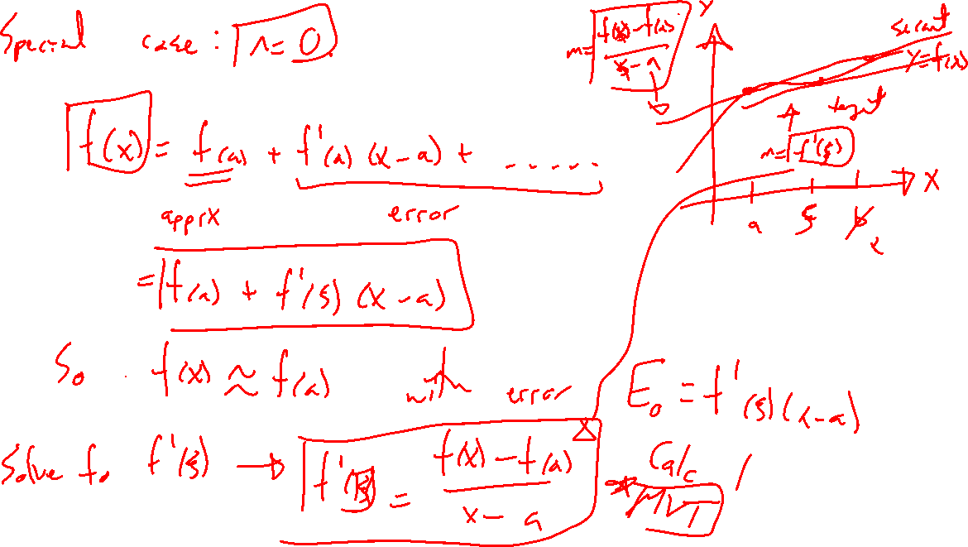

Slide 6
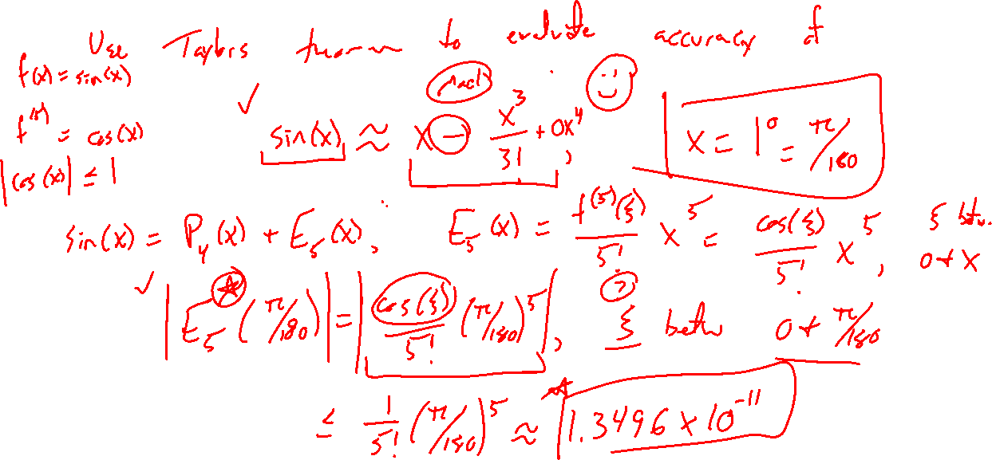
Example: Try on own
Notes:
How accurate is sin(x) \approx x-x^3/3! for x=1?
Use Taylor's theorem with n=4 since 4th term is zero.
Check in Desmos.

Slide 7
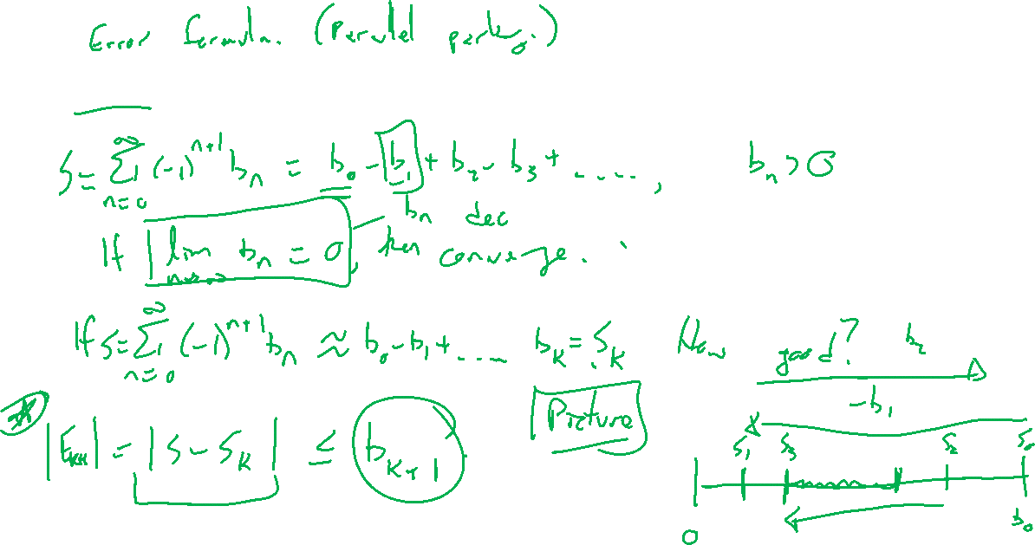
AST: An alternate approach
Notes:
AST reminder and the remainder theorem.
Sum_{n=1}^\infty (-1)^{n-1} a_n, a_n > 0.
Then |S-S_n| \leq a_{n+1}.
Proof by parallel parking.

Slide 8

Example: Try on own
Notes:
How accurate is sin(x) \approx x-x^3/3! for x=1? Use AST

Slide 9
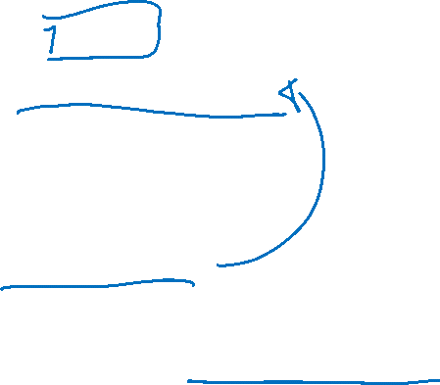
Section 1.2: Textbook Examples and Exercises
Theorem proofs: None
Text examples 1, 3, 5, 6, 7, 8, 10.
Write down a problem. Close the book and attempt on own.
Check / correct your solution against the text solution.
If needed, rewrite the problem to be of the quality of the text solution.
Text exercises 1, 2, 6, 8, 35.
Write solutions of the same quality as in lecture and text solutions.
Text computer exercises 1, 7, 16, 17, 24.
Record screenshots of your script and corresponding outputs.
Notes:
Recommend 3blue1brown Taylor series video

Slide 10

Homework Submission to Canvas
Preview of section
Skim the section in text and write a short paragraph summary.
Give a bulleted list of all important definitions, theorems, and formulas without details.
Notes on video lectures
Take notes on everything written on slides including all details, worked examples, on-own activities, as well as your own thoughts and questions.
Try on-own activities first, then write down provided solution next to it for comparison.
Worked examples from the text
Write down the problem and attempt without looking at the solution.
Use the solution to write the best explanation you can.
Solutions to textbook exercises
Model approaches and explanations given in the video lectures and textbook examples.
Final reflection of section
List the key takeaways to remember as a bulleted list.
Notes:
Mention graded for completion and quality of writing.

